Slide 1
JAXP 1.4
Param_kaliyamoorthi@yahoo.com
Notes:
<number>

Slide 2
Schema Validation
JAXP 1.4
( JAXP add PLUG ability of XML processing in java )
XML Document Parsing
XML document transformation
Xpath Manipulation
JAXP also is HOLLOW API as JDBC, JavaMAIL, JMS
Notes:
<number>

Slide 3
THREE Programming Models of JAXP
PUSH Model ( Event driven )
It use “Observer” design Pattern
SAX
Developed by W3C
OBJECT Model
DOM
Used by LS, Xpath, Range, Traversal
It use “ITERATOR” design pattern
Developed by SUN
PULL Model
StAX
Notes:
<number>

Slide 4
Layered JAXP API and Their backbone support
Traversal API
LS
XPATH
TrAX
Validation
DOM
StAX
SAX
JAXP ( JAVA 1.5)
XML
XSL
XSD
…..Kalakkura param …..

Slide 5
Common of usage
Create Factory ( SAX / DOM / TrAX / Validation / Xpath /StAX)
Create Parser ( SAXParser / DocumentBuilder / Transformer/ Validator / Xpath / StreamReader/Writer )
Create XML / XSL / XSD source
Call the parser to parse

Slide 6
Different Level of configuration on JAXP Factories
FEATURE are different technologies comes from W3C like Namespace, LS, Range, DOMSource and etc
Values are BOOLEAN
Feature
The name of FEATURE and ATTRIBUTE mostly represented as URL
Values are OBJECT
Attribute / property
These are Factory implementation dependent configuration

Slide 7
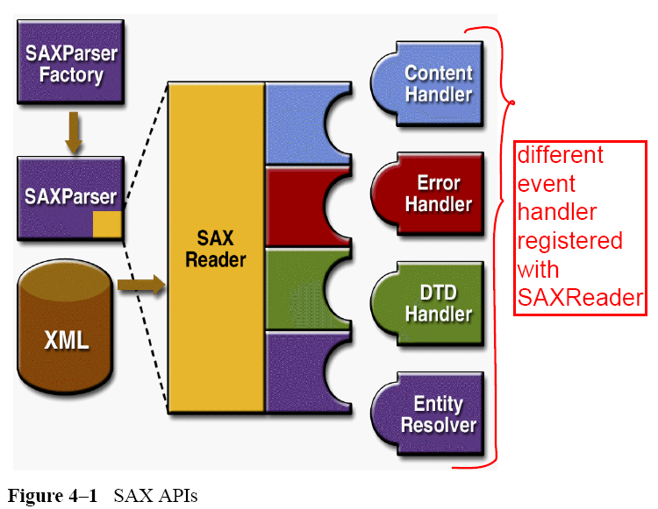
Notes:
<number>

Slide 8
Open IDE
Begin Here
Create object for SAXParserFactory
SAXParserFactory
Retrieve SAXParser object from Factory
DefaultHandler
SAXParser
Retrieve XMLReader object from SAXParser
Implement any of these Event Handler
ContentHandler
XMLReader
Register with either SAXParser of XMLReader
ErrorHandler
LexicalHandler
Invoke Parse Method in either SAXParser or XMLReader
End

Slide 9
SAX API ( 13 )
2 -Factory
2 -Reader
SAXParserFactory
SAXParser
XMLReaderFactory
XMLReader
4 - Handlers
Others
DefaultHandler
1 - Attribute
ContentHandler
4 - Exception
1 - Locator
ErrorHandler
1 - Filter
1 - InputSource
LexicalHandler

Slide 10
SAX parsing Exception
It will be used in SAX, DOM, TrAX
Java.lang.Exception
ParserConfigurationException
SAXException
SAXNotRecognizedException
SAXParseException
SAXNotSupportedException
These two are used only in setting/ getting FEATURE

Slide 11
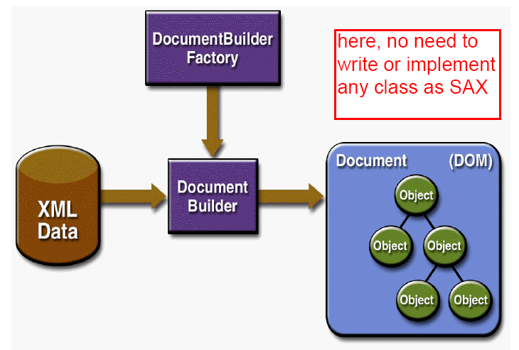
WAY - I
Notes:
<number>

Slide 12
Olympic LINGS among DOM Components of a XML File Representation
Begin here
documentfragment
Document
Comment
Element
Attr
CDATASection
Text
Notes:
<number>

Slide 13
DOM UML design
( no of methods )
Collection based LIST for Node
Begin here
UserDataHandler
NodeList
Node
( 37 )
TypeInfo
Element
( 20 )
CharacterData
( 8 )
Attr
( 7 )
DocumentFragment ( 0 )
Document
( 28 )
NamedNodeMap
Text
( 4 )
Comment ( 0 )
Collection based MAP for Node
DOMConfiguration
DOMImplementation
CDATASection
( 0 )

Slide 14
DOM API
Others
TypeInfo
DOMConfiguration
DOMException
DocumentBuilderFactory
DocumentBuilder
DOM Components
2 - Handler
Node
Document
Element
Attr
CharacterData
Text
Comment
CDATASection
NodeList
NamedNodeMap
UserDataHandler
DOMErrorHandler
DOMError
DOMLocator
Notes:
<number>

Slide 15
Begin Here
Act as Factory
It is Actually Type Casted Document object
DocumentTraversal ( 2 )
It is actually works ONLY with Document TREE. This API is not to parser or save
NodeIterator can be used with any NodeList / subtree / xpath query result
TreeWalker ( 13 )
NodeIterator ( 7 )
TreeWalker can use ONLY with SubTree of nodes, even NOT sibling
DOM Traversal API
NodeFilter ( 1 )

Slide 16
DOM LS API
WAY - II
I can use LS as counterpart to actual CORE DOM API
Begin Here
DOMImplementationLS ( 4 )
DOMConfiguration
LSInput
LSParser
LSOutput
LSSerializer
LSLoadEvent
LSProgressEvent
LSSerializerFilter
LSParserFilter
LSResourceResolver

Slide 17
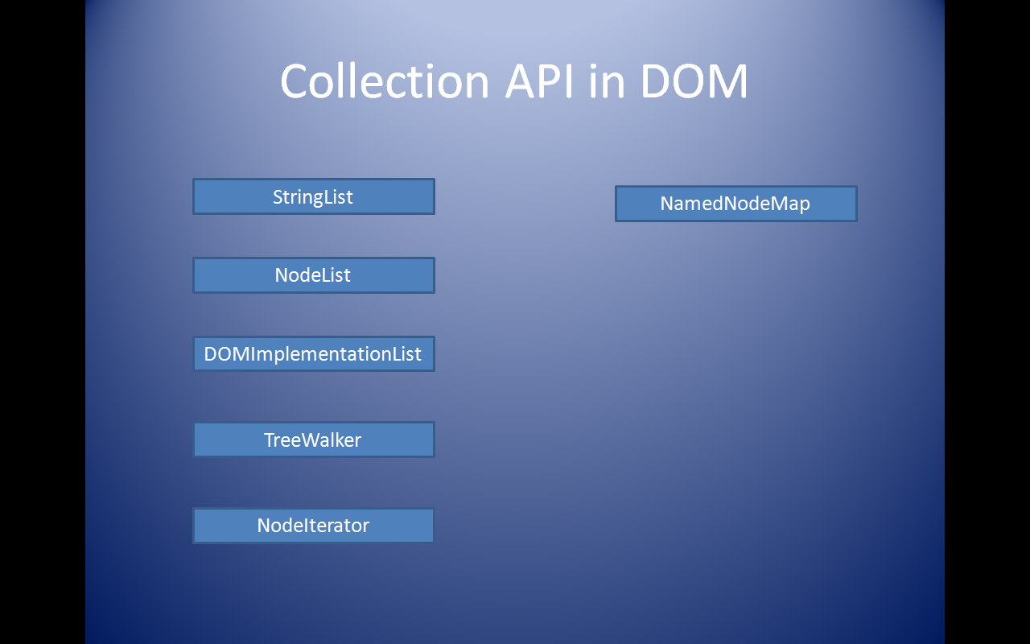
Collection API in DOM
StringList
NamedNodeMap
NodeList
DOMImplementationList
TreeWalker
NodeIterator

Slide 18
JVM Plug-in
If we write a Exception analyzer it will analyses the exception’s root cause and then forward to actual application.
This will be help full for JAVA DEVELOPER without writing any more code and run just to know cause of exception
Java Application
Exception Analyzer
JVM
I could not. If possible just let me know too
Different level diagnostic for different exception

Slide 19
PULL Model of JAXP (StAX )
Since the client application controls the process, it's easy to write separate methods for different elements. These methods can have detailed knowledge of the internal structure of the type of element they are handle
http://www.xml.com/pub/a/2003/09/17/stax.html?page=2
http://www.j2ee.me/webservices/docs/1.6/tutorial/doc/SJSXP.html
It is introduced by SUN and BEA
StAX API has 8 kinds of events
Begin Here
Like SAX API ,the cursor API methods return XML information as strings, which minimizes object allocation requirements
StAX
Treating streaming of events
Pull Model clients can read multiple documents at one time with a single thread
Event API
Cursor API
https://sjsxp.dev.java.net/
Realized in appropriate Events in JAVA Objects
Un realized events. (i.e.)not represent in event object
StAX can start generating output from the input almost immediately, without waiting for the entire document to be read

Slide 20
StAX API
XMLStreamReader
Begin Here
StreamFilter
Location
XMLInputFactory
EventFilter
XMLEventReader
XMLStreamWriter
Begin Here
XMLStreamException
XMLOutputFactory
XMLEventWriter
Notes:
<number>

Slide 21

Begin Here
StAX Event Model API
Note that the DTD, EntityDeclaration, EntityReference, NotationDeclaration, and ProcessingInstruction events are only created if the document being processed contains a DTD
XMLEventFactory
Attribute, Namespace are secondary events
XMLStreamConstants
XMLEvent
EndElement
StartElement
StartDocument
EndDocument
Comment
Characters
Attribute
XMLStreamReader is more efficient, but XMLEventReader is easier to use, as all the information related to a particular event is encapsulated in a returned XMLEvent object. However, the disadvantage of event approach is the extra overhead of creating objects for every event, which consumes both time and memory
Secondary events like Attribute and namespace are cannot read from xmlEventReader. It has to get from their resspective parent
Namespace
Notes:
<number>

Slide 22
StAX API
3 Factory
4 – XML IO’s
XMLInputFactory
XMLOutputFactory
XMLEventFactory
XMLStreamReader
XMLStreamWriter
XMLEventReader
XMLEventWriter
Domain objects
2 - Filter
StartDocument
EndDocument
StartElement
EndElement
Attribute
Characters
Comment
Namespace
XMLEvent
StreamFilter
EventFilter
Others
XMLStreamException

Slide 23
JAXP Exception
Java.lang.Exception
FactoryConfigurationError
SAXException
ParserConfigurationException
TransformerException
SAXParseException
SAXNotRecognizedException
TransformerConfigurationException
Extend from RuntimeException
SAXNotSupportedException
XMLStreamException
DOMException
RangeException
LSException
Notes:
<number>

Slide 24
Begin Here
TransformerFactory
( Compiler for XSL Files )
TrAX API Model
SAXTransformerFactory
SourceLocator
TransformerHandler
TemplatesHandler
ErrorListener
URIResolver
Templates
Transformer
we have to call XMLReader.parser() method explictly when using SAXTransformerFactory and no need to call transform method .
But in SAXSource we never call parse method of XMLReader explictly and but have to call transform() method on transormer
OutputKeys
Source
Result
StreamSource
StreamResult
SAXSource
SAXResult
DOMSource
DOMResult
DOMLocator
StAXSource
StAXResult

Slide 25
TrAX API
2 - Factory
Transformer
Templates
TransformerFactory
SAXTransformerFactory
Others
10 – Domain object
TransformerHandler
TemplatesHandler
DOMLocator
URIResolver
SourceLocator
ErrorListener
OutputKeys
SAXSource
DOMSource
StreamSource
StAXSource
SAXResult
DOMResult
StreamResult
StAXResult
Source
Result
2 -Exceptions
TransformerConfigurationException
TransformerException

Slide 26
JAXP - Validation API ( since JAXP 1.3 )
Begin Here
http://java.sun.com/developer/technicalArticles/xml/jaxp1-3/ValidationFramework.zip
SchemaFactory
( Compiler for XSD files )
ErrorHandler
SAX API
LSResoruceResolver
DOM LS API
Schema
ContentHandler
Same facility available in TrAX too
Validator
ValidatorHandler
Used to validate SAX Event with schema
Any Type of SOURCE
TypeInfoProvider
If u want schema type
Notes:
<number>

Slide 27
JAXP - XPATH API ( since JAXP 1.3 )
XPathFactory
Begin Here
XPathVariableResolver
XPathFunctionResolver
It is just compiler. Not to represent Xpath
Xpath
(Compiler Xpath Expression )
XPathFunction
XPathExpression
It is represent on memory of Xpath expression
XPathException
XPathExpressionException
XPathFactoryConfigurationException
XPathFunctionException
Notes:
<number>

Slide 28
☺ Param Here ☺ | ☺SAX | DOM | StAX | JDOM | Validation API
Schema Validation | Yes | Yes | NO | Depends on SAX Parser | BEST
Read from Start to END | yes | Yes (worst) | BEST | Yes (Easy Coding) | Not Applicable
Write from Start to END | NO | Yes | BEST | Yes ( easy of coding ) | No Applicable
Need Alternative to DOM for easy of JAVA Coding | No Applicable |  | BEST ( easy of coding ) | Yes ( easy of coding ) | Not Applicable
Want access / update at random positioned element | NO | Yes ( costly , and difficult for coding ) | NO ( I Not sure ) | BEST ( using Xpath or simply use of java collection ) | Not Applicable
Need of Event notification of every part of XML | BEST | NO | Yes ( some what ok ) | No | Not Applicable

Slide 29
Table 3-1 XML Parser API Feature Summary
Feature | StAX | SAX | DOM | TrAX
API Type | Pull, streaming | Push, streaming | In memory tree | XSLT Rule
Ease of Use | High | Medium | High | Medium
XPath Capability | No | No | Yes | Yes
CPU and Memory Efficiency | Good | Good | Varies | Varies
Forward Only | Yes | Yes | No | No
Read XML | Yes | Yes | Yes | Yes
Write XML | Yes | No | Yes | Yes
Create, Read, Update, Delete | No | No | Yes | No

Slide 30

Thanks Param

